Slide 1
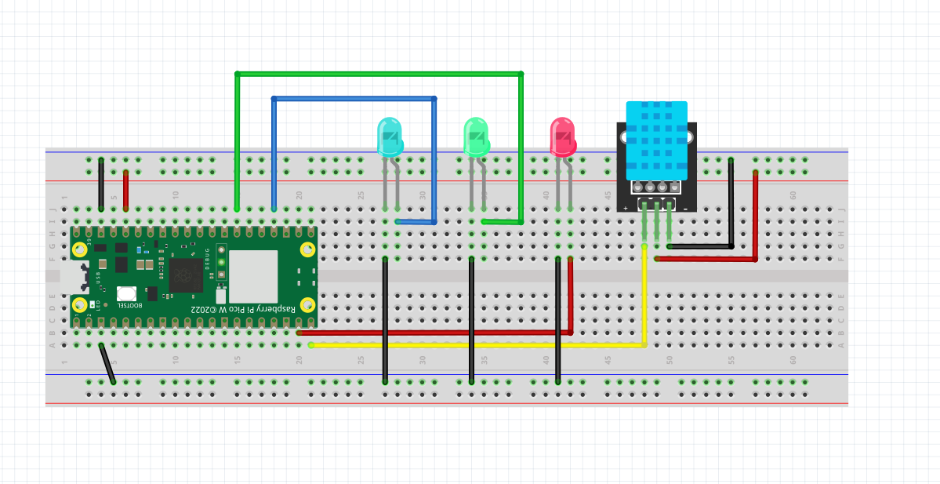
Wiring Diagram for 14 Jul Meeting
Green LED – Pin 21
Blue LED – Pin 18
Red LED – Pin 14
DHT11 – Pin 15

Slide 2
Setting the Pico W as an Web Server
Sending Instructions to Server
Reference Video
https://core-electronics.com.au/guides/raspberry-pi-pico-w-create-a-simple-http-server/
picowebserver.py
index.html
wificonfig.py

Slide 3
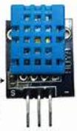

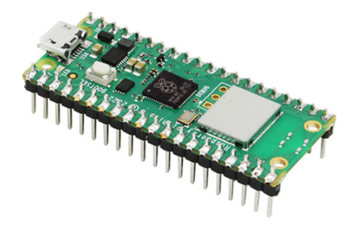
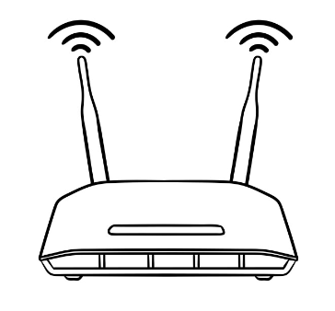
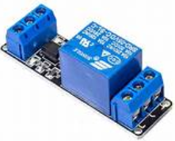
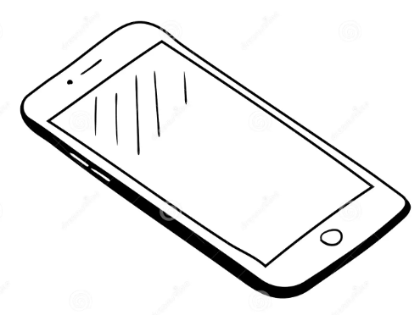
SSID=VirusGenerator
Password=VGAquarius090317
Webserver
192.168.4.3
Router
LOCAL AREA NETWORK
192.168.4.3

Slide 4
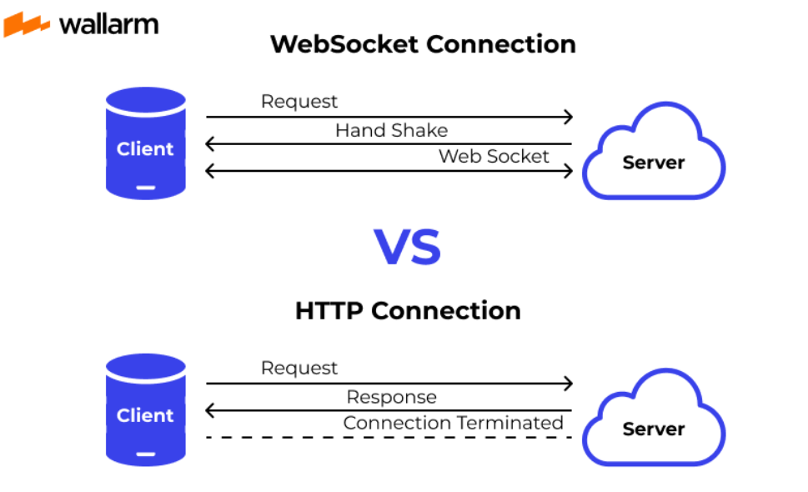
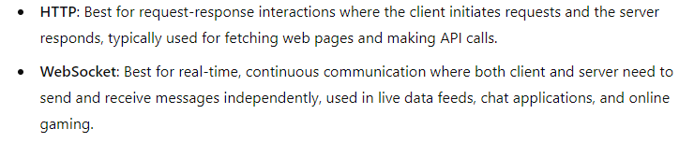

Slide 5
Send instructions to a microcontroller - remotely
Retrieve information from a microcontroller - remotely

Slide 6
Anatomy of a Pico Web Server

Slide 7
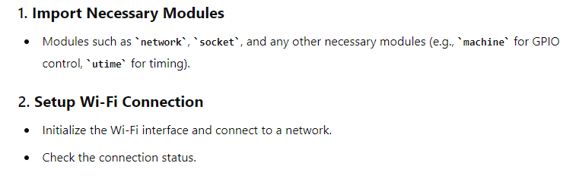
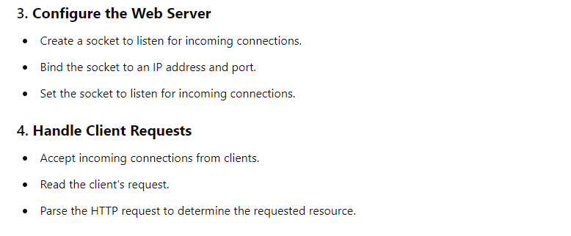
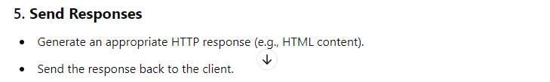

Slide 8

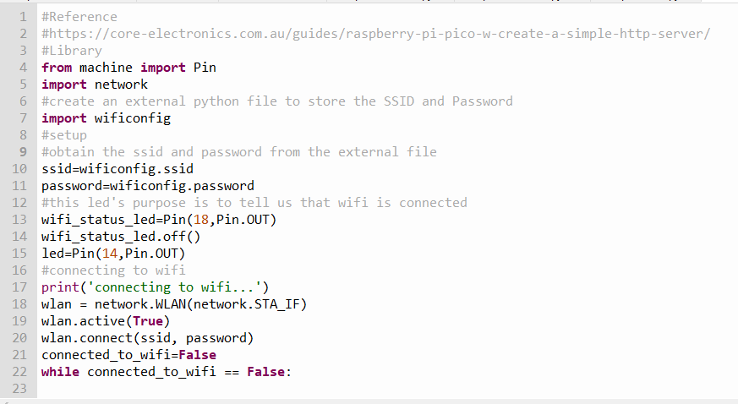

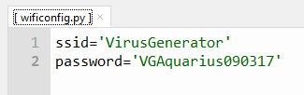
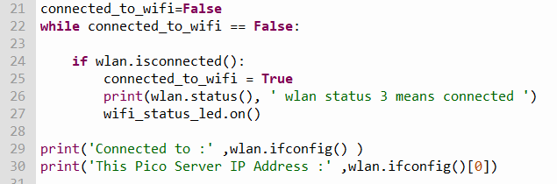
picowebserver.py

Slide 9

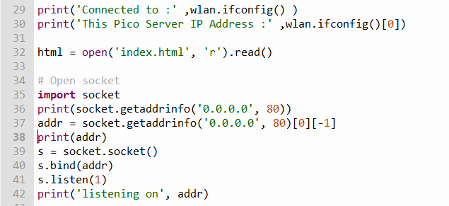
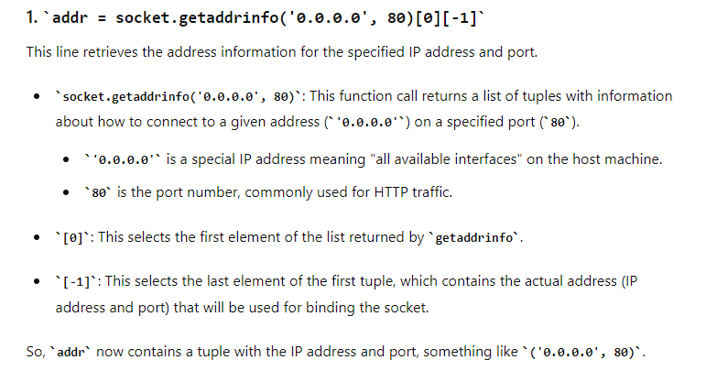
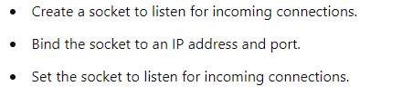

Slide 10

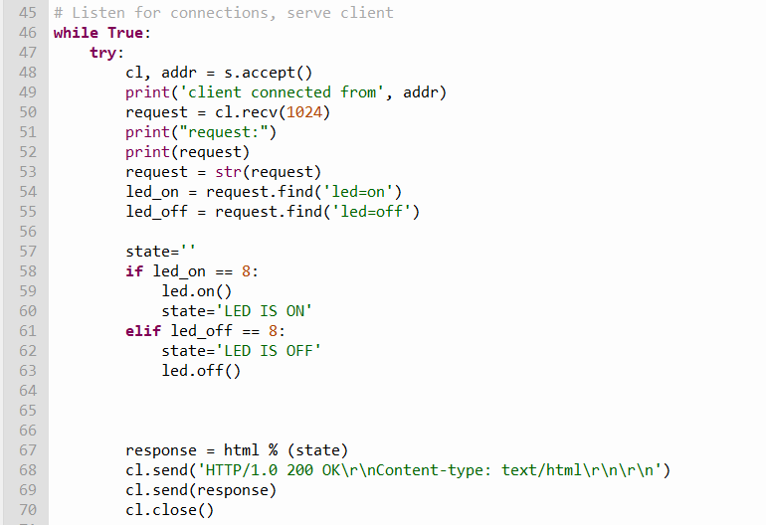

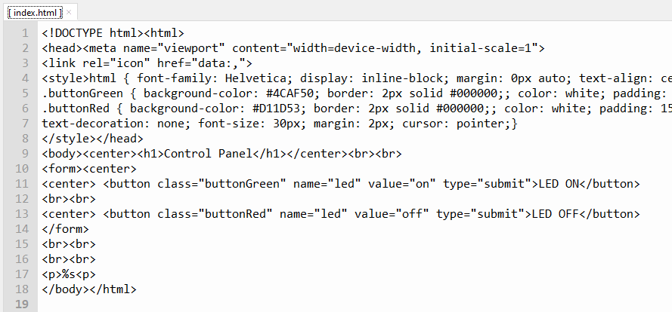


Slide 11
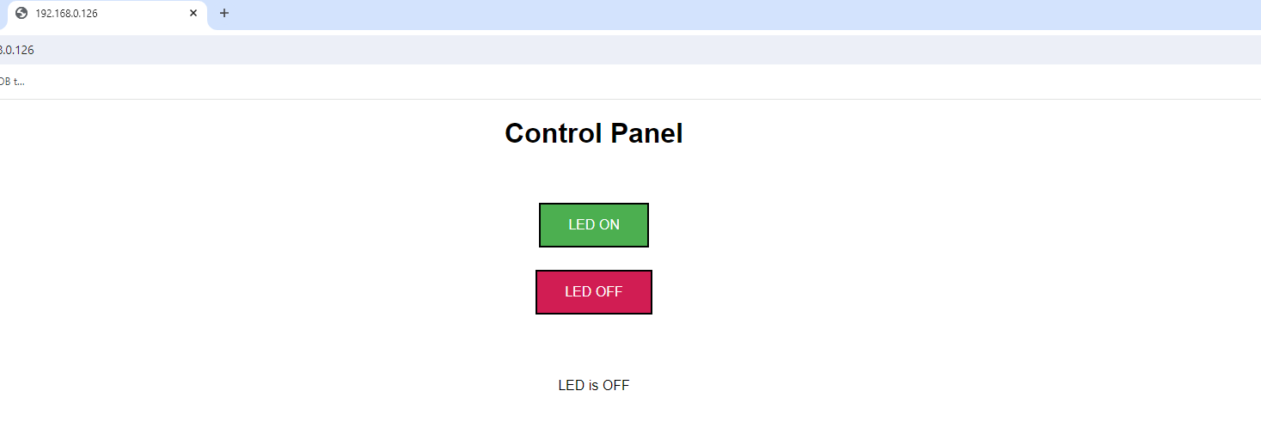
DEMO
Sending Instructions to a Webserver

Slide 12
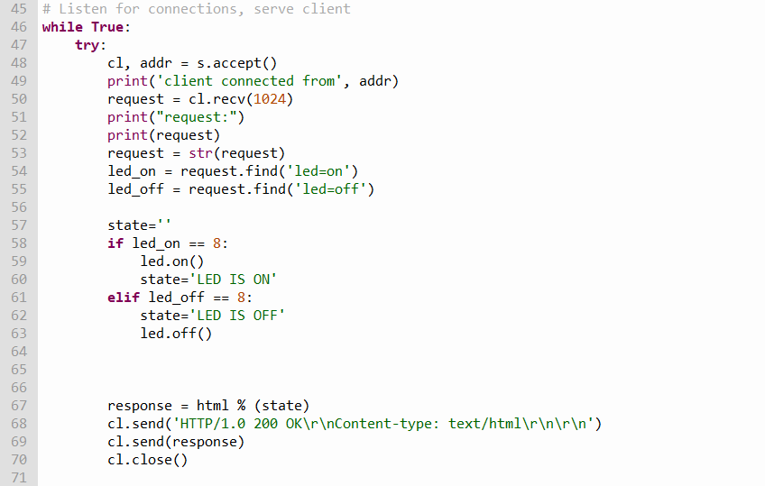
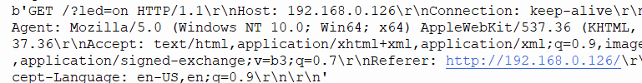
Position 8

Slide 13
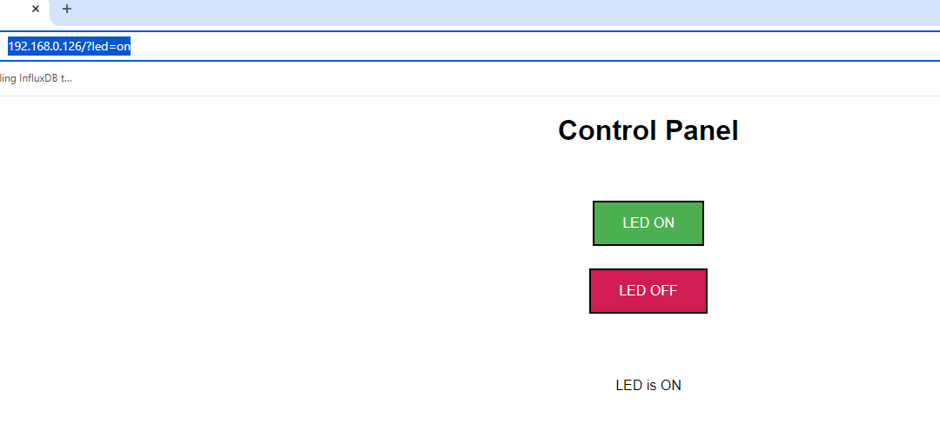
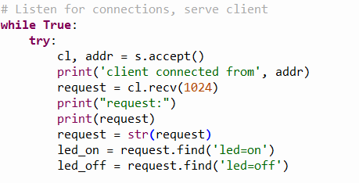
Position 8

Slide 14

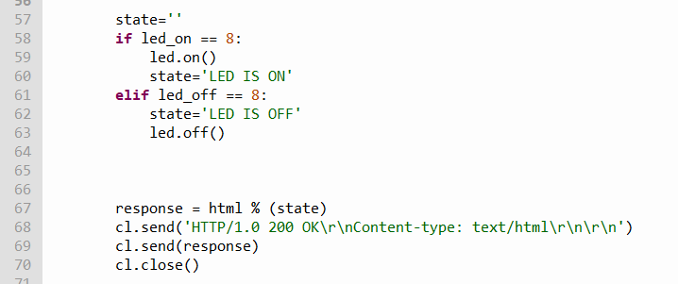

Slide 15
DEMO

Slide 16
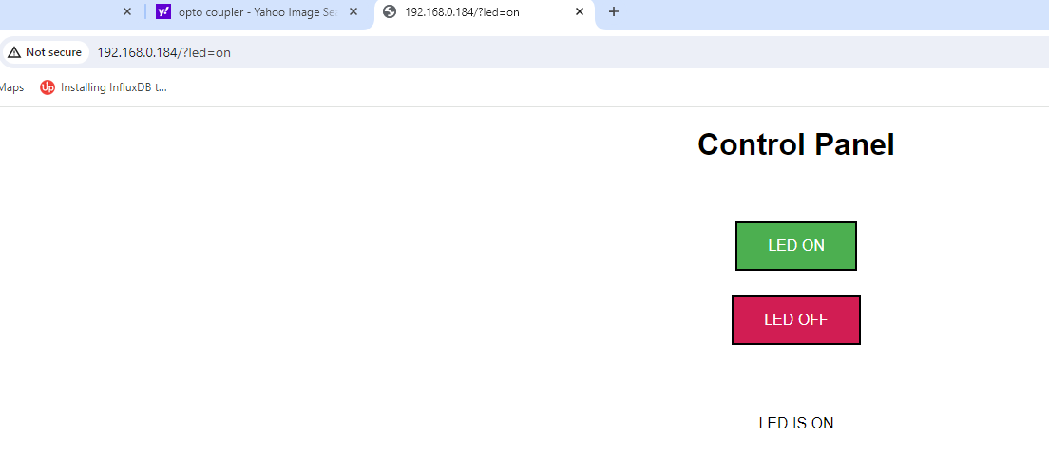

Slide 17
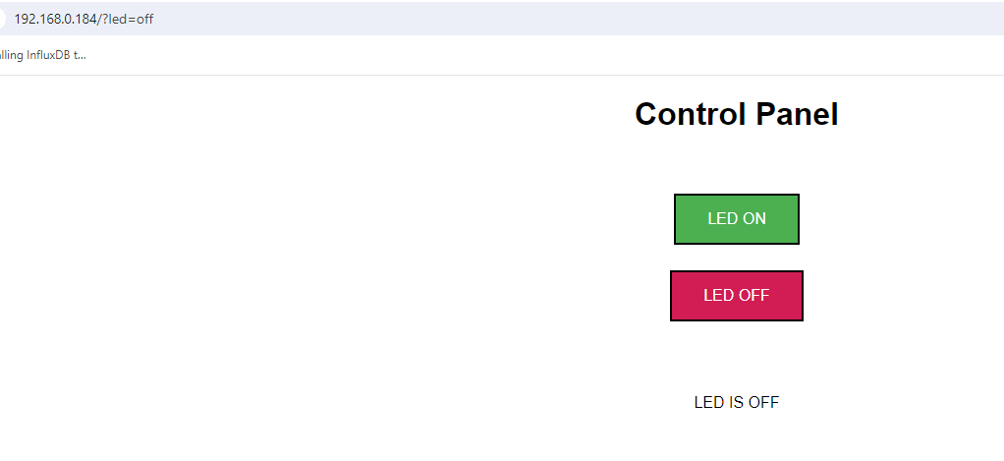
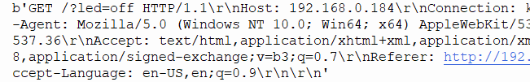
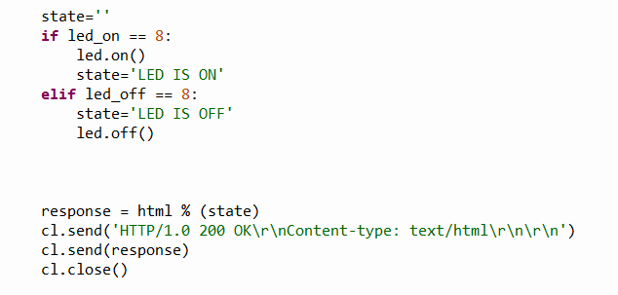

Slide 18
DEMO
Retrieving Information from a Webserver

Slide 19
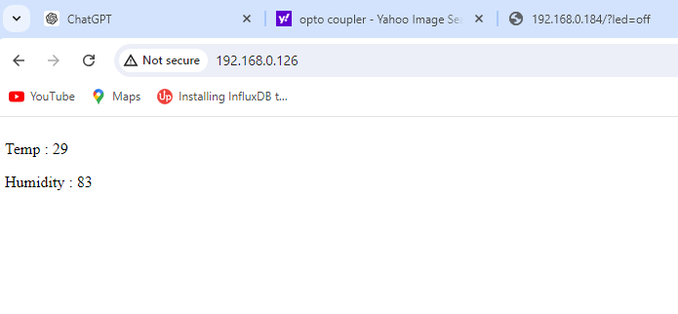

Slide 20
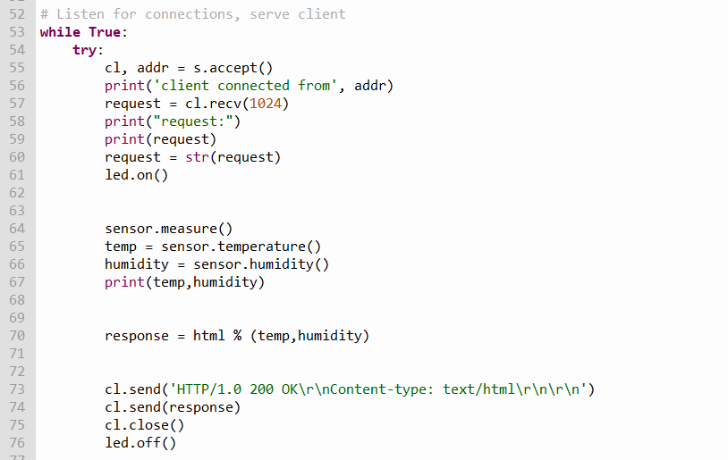
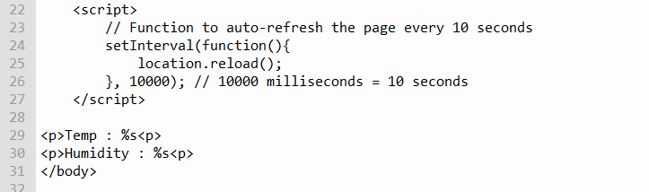
Instead of a submit button
We use a timer to send our
Request to the server

Slide 21
Setting the Pico W as an AP (Access Point)
setupAPmode.py

Slide 22
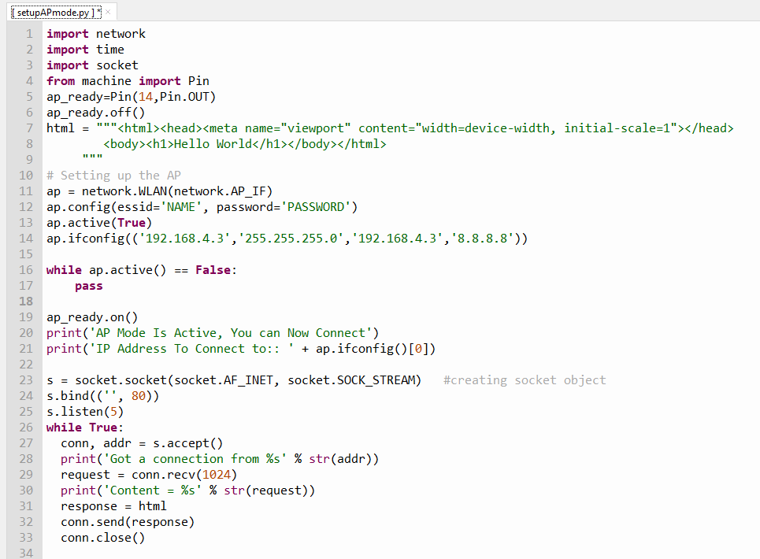

Slide 23
ap.ifconfig(('192.168.4.3','255.255.255.0','192.168.4.3','8.8.8.8'))
1. **`'192.168.4.3'`**: This is the IP address assigned to the access point interface. Devices connecting to this access point will use this IP address to communicate with it.
2. **`'255.255.255.0'`**: This is the subnet mask. It determines the network's size and which IP addresses are considered to be on the same local network. A subnet mask of `255.255.255.0` means that the first three octets (192.168.4) define the network, and the last octet (the .3 part) defines the specific device on that network.
3. **`'192.168.4.3'`**: This is the gateway address. In the context of an access point, it often points to the IP address of the access point itself, meaning that the device will route traffic through itself.
4. **`'8.8.8.8'`**: This is the DNS (Domain Name System) server address. It is used to resolve domain names to IP addresses. In this case, it uses Google’s public DNS server, which is commonly used and widely available.
In summary, this line configures the access point interface with a specific IP address, subnet mask, gateway, and DNS server. This setup is necessary for the proper functioning of the access point, enabling connected devices to communicate with each other and resolve domain names to IP addresses.

Slide 24
SSID=NAME
Password=PASSWORD
Webserver
Access Point (AP)
LOCAL AREA NETWORK

Slide 25
Reference Video
https://youtu.be/cZNoXXIEPbg?si=BkbN4mNENU4vg4z0
https://youtu.be/78sViOl9ZuM?si=PBRb3Vhujrawf8tH

